Slide 1
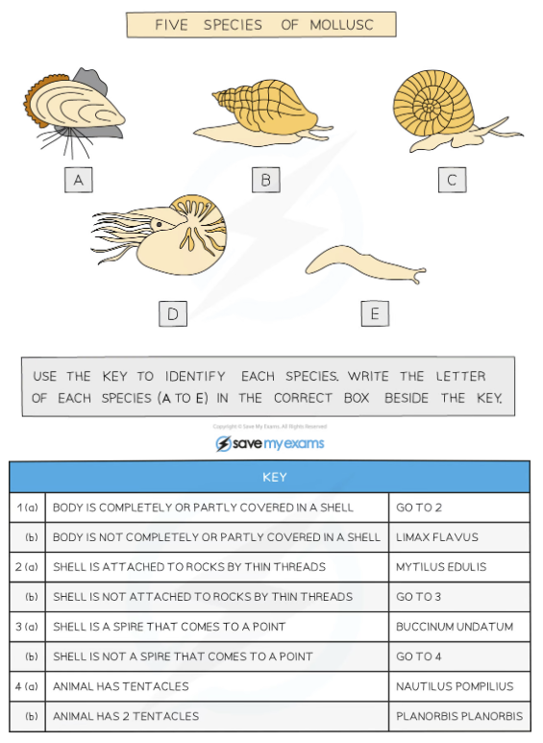
Classification Revision Name: ______________
Q1. Arrange these levels of classification from least similar to most similar:
Genus Order Class Family Kingdom Species Phylum
Q2. Which organisms are the most similar and why?
Q3. Use the tabular key to identify these organisms.
A
B
C
D
E
 | Organism 1 | Organism 2 | Organism 3
Kingdom | Animalia | Animalia | Animalia
Phylum | Chordata | Chordata | Chordata
Class | Mammalia | Mammalia | Mammalia
Order | Primates | Primates | Rodentia
Family | Lemuridae | Homindae | Muridae
Genus | Lemur | Homo | Mus
Species | Lemur catta | Homo sapiens | Mus musculus

Slide 2
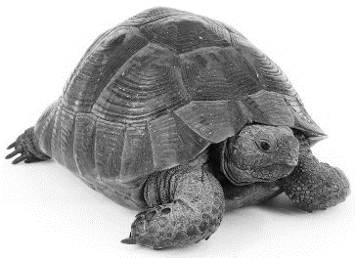
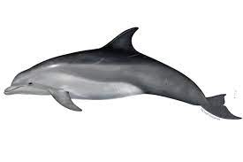
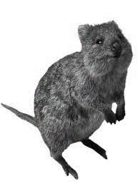
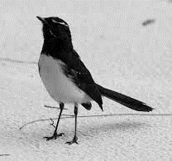
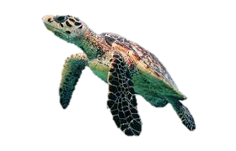
Q4. Create a dichotomous key for the following organisms.
tortoise | dolphin | quokka | willy wagtail | turtle

Slide 3
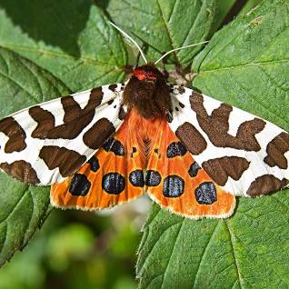
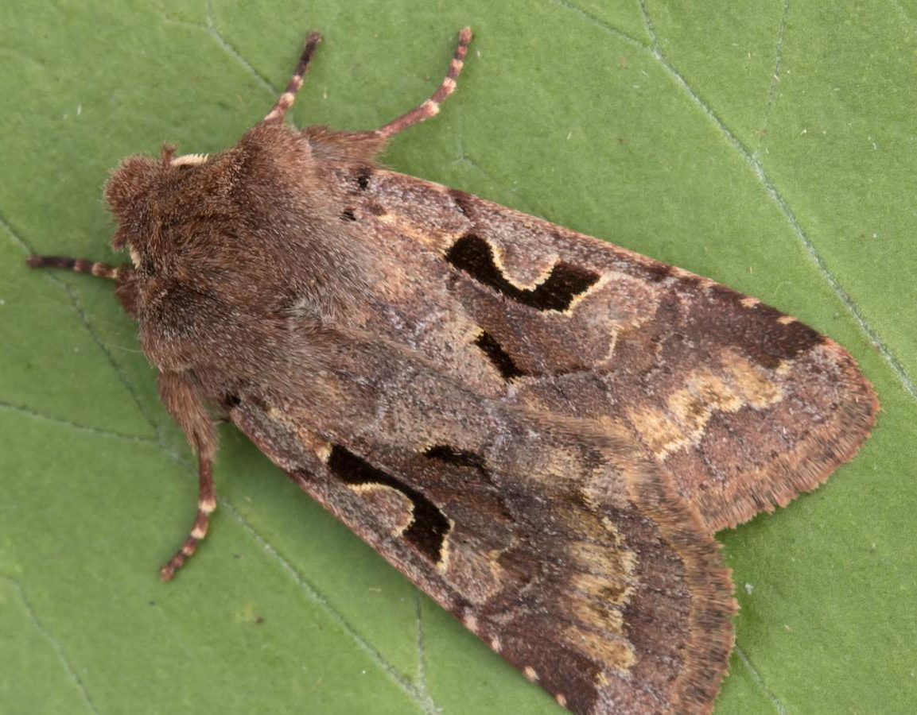
Classification Revision - Moths Name: ______________
Read the text and answer the questions:
Moths are fascinating creatures that come in many different colours and patterns. Like butterflies, moths have special colours that can be used for camouflaging into their natural environment or scaring off predators. Four moth species with different colourations are the Common Quaker, the Hebrew Character moth, the Elephant Hawk Moth, and the Garden Tiger Moth.
The Common Quaker is a moth with wings that are mostly brown. They have a mix of light and dark shades of brown, which helps them hide on tree bark and leaves during the day when they rest. This way, they can avoid being seen by birds or other animals that might try to eat them. Similar in colour to the Common Quaker is the Hebrew Character moth. It shares the same brownish colour but can be distinguished by the distinct pattern on its wings. It has a dark shape that looks like a letter C (or the Hebrew letter ‘nun’).
The Elephant Hawk Moth is a bigger moth with wings that are mostly pink. They also have olive green and brown markings on their wings. These colours act as a warning to predators, telling them that the moth might not taste good or could even be harmful. By having bright pink colours, the Elephant Hawk Moth warns potential predators to stay away.
The Garden Tiger Moth is a moth with wings that are mostly white. They have bold black markings and patches of orange. These colours help them to stand out and warn predators that they might not be a good meal. When they feel threatened, they show their bright colours and spread their wings to scare away predators.
Moths are amazing creatures with different colours and ways of staying safe. Whether it's the brown shades of the Common Quaker, the pink warning colours of the Elephant Hawk Moth, or the contrasting black and orange of the Garden Tiger Moth, these moths show us the beauty and cleverness found in nature.
Q1. Identify these moths.
Q2. Give two reasons why moths have special colours?
Q3. The Common Quaker and Hebrew Character moth usually rest on the trunks and branches of trees. Explain why they rest here and not on the leaves of trees.

Slide 4
Q4. What observable features can be used to tell these moths apart?
Q5. Create a dichotomous key for these four species of moth.

